Slide 1

EDA - Ride Fare Dataset
Yousef Mahmoud Ali
ML Group 2

Slide 2
Data overview
500,000 records with total 26 features, including:
Driver information
Trip details (Distance, time, and fare)
Weather & traffic conditions
Geographic coordinates and airport distances

Slide 3
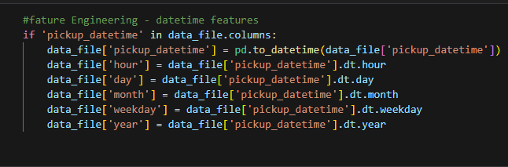
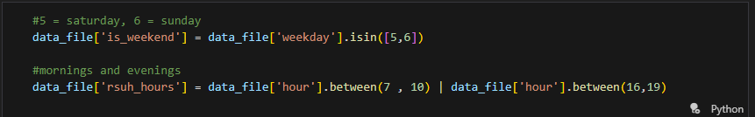

Feature Engineering
Created new features for the date time
Created special new features

Slide 4
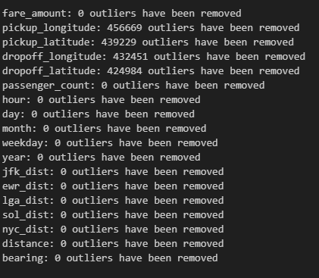
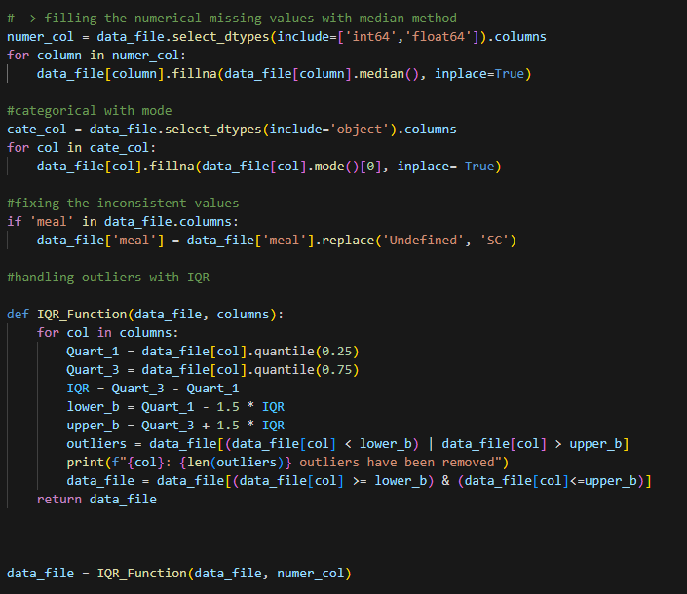
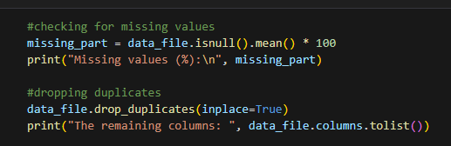
Data Cleansing
Applied IQR Method to clean the outliers
Removed Duplicates
Handled Missing Values

Slide 5
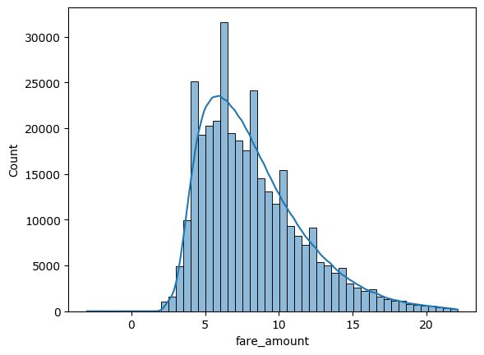
Fare Distribution
Most of the fares are between ~&5 - &15
Long tail distribution with some higher fares

Slide 6
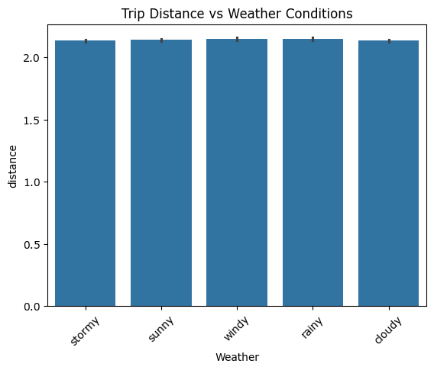
Weather Impact on Trips
Most of the hours share the same distance
No extreme outliers based on weather conditions

Slide 7
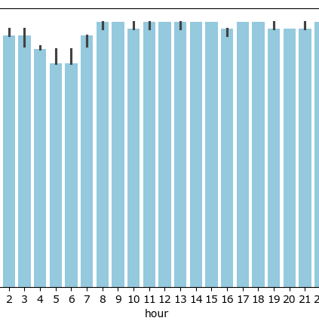
Rush Hour Analysis
Almost all the hours share the same peak
At some early time of the day, the fare goes down a bit

Slide 8
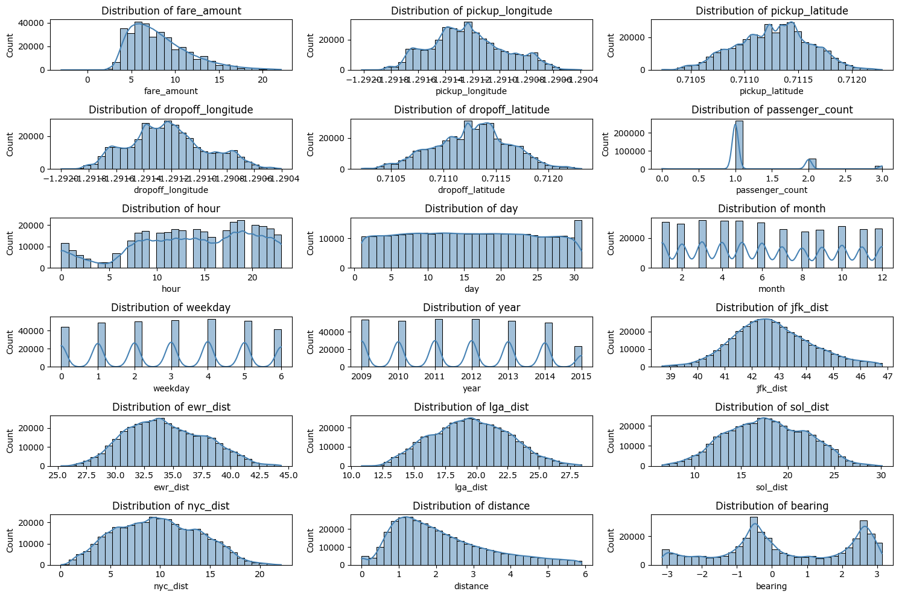
Distributions of each feature
Behavior of each feature in the data set

Slide 9
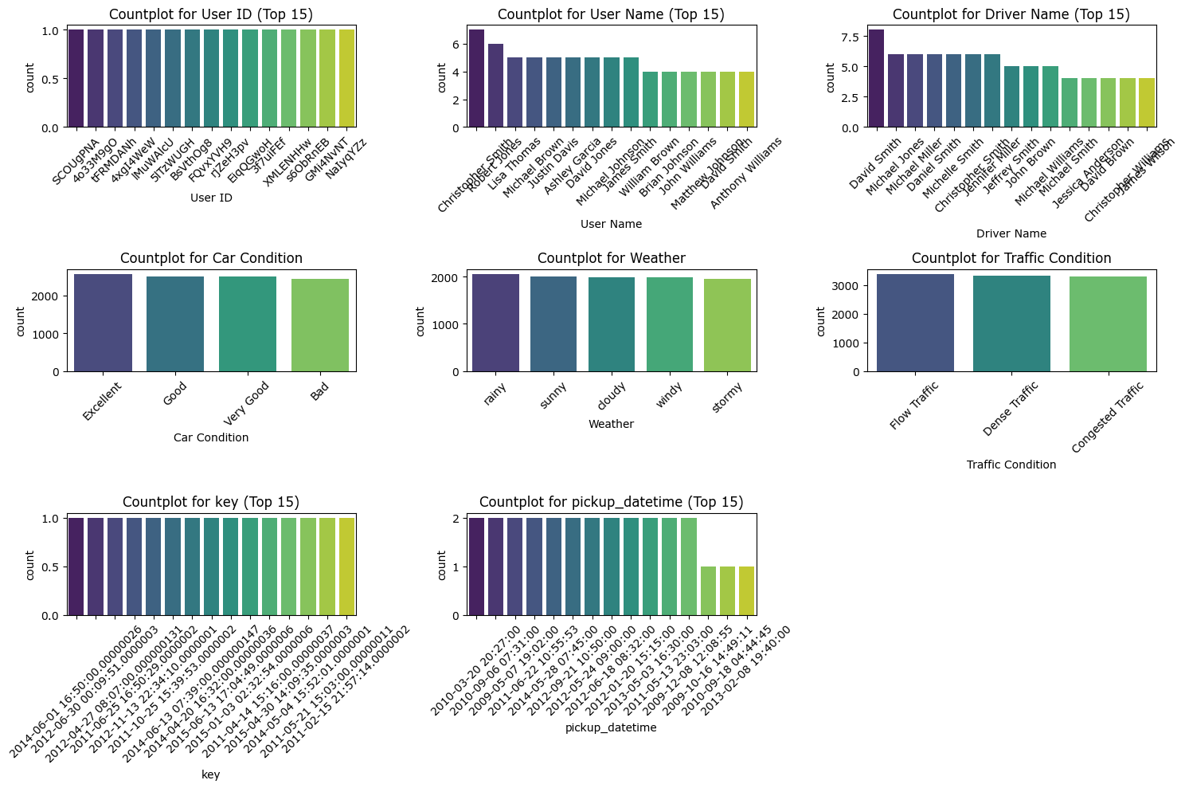
Countplots for Categorical Features
If the category has too many unique values ">15", it shows just the top 15 most common values.
Avoiding memory problems and time for plotting

Slide 10
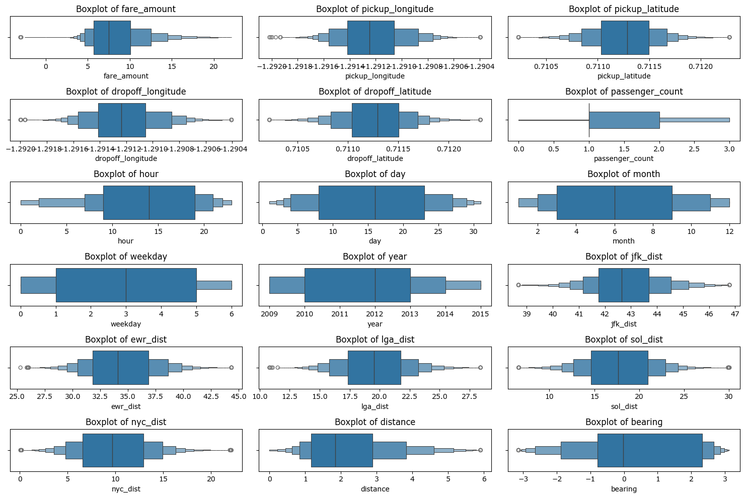
Boxenplots for Numerical Features
Shows the distribution, median, IQR, and outliers for each variable.

Slide 11

Thank you
Questions?

